Slide 1
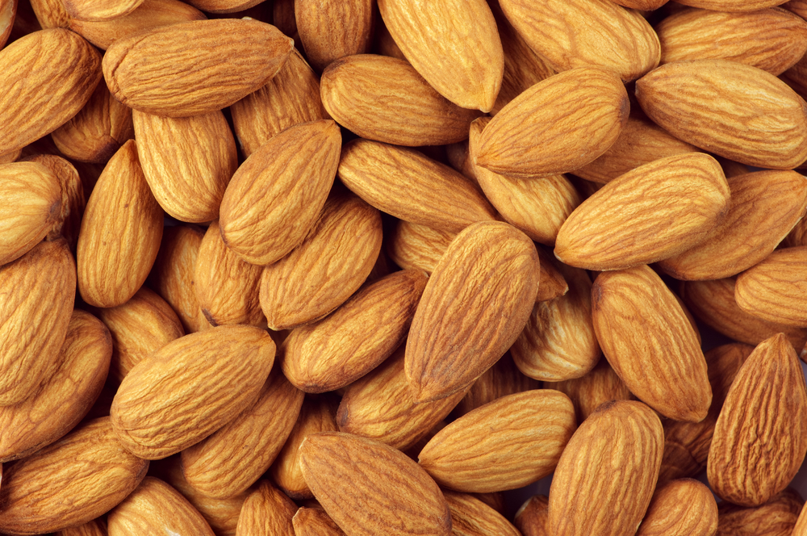
Benefits of consuming
Almonds
Almonds are often mistaken for tree nuts,
but are actually the seeds of the almond tree.
They are rich in antioxidants, healthy fats, minerals and fiber.
For more information, visit our website:
www.advancedhealth.com/healthy-bytes-initiative

Slide 2
Benefits of consuming
Benefits of consuming
Millet
Almonds
1 ounce raw almonds (about 24) provides:
165 Calories
6 gm protein
3.5 gm fiber
14 gm unsaturated fat
No cholesterol
For more information, visit our website:
www.advancedhealth.com/healthy-bytes-initiative

Slide 3
Benefits of consuming
Almonds
Almonds contain vitamin E, an antioxidant that helps fight
free radicals and prevent or delay the progression of chronic diseases.
For more information, visit our website:
www.advancedhealth.com/healthy-bytes-initiative

Slide 4
Benefits of consuming
Almonds
Almonds are rich in healthy unsaturated fats like omega-3 fatty acids, which help decrease inflammation, lower cholesterol and triglycerides
and reduce risk of heart disease.
For more information, visit our website:
www.advancedhealth.com/healthy-bytes-initiative

Slide 5
Benefits of consuming
Almonds
Almonds are a good source of calcium, phosphorus and magnesium
for healthy bones, teeth and muscle contraction,
including the heart muscle.
For more information, visit our website:
www.advancedhealth.com/healthy-bytes-initiative

Slide 6
Benefits of consuming
Almonds
Almonds can be purchased raw or roasted, slivered, sliced, or chopped. Choose raw almonds over salted, roasted or candy coated.
For more information, visit our website:
www.advancedhealth.com/healthy-bytes-initiative

Slide 7
Benefits of consuming
Benefits of consuming
Lentils
Almonds
Although high in Calories, almonds may lower risk of obesity.
For more information, visit our website:
www.advancedhealth.com/healthy-bytes-initiative

Slide 8
Benefits of consuming
Almonds
Aim for 2 or more 1-ounce servings per week.
One serving is ¼ cup or about 24 almonds.
Store in refrigerator or freezer to prevent spoiling.
For more information, visit our website:
www.advancedhealth.com/healthy-bytes-initiative

Slide 9
Benefits of consuming
Almonds
Almonds can be enjoyed as a snack, or sliced into oatmeal,
yogurt or salad, tossed in muffins or pancakes, or added to smoothies.
Or make your own almond milk with just raw almonds and water.
For more information, visit our website:
www.advancedhealth.com/healthy-bytes-initiative

Slide 10
Benefits of consuming
Almonds
Make almond milk at home.
Soak raw almonds in water overnight in the fridge.
Drain and add to blender with 5 cups fresh water and a pinch of salt.
Blend 2 minutes. Drain through nut bag or cheesecloth,
squeezing out all liquid. Store in fridge 4-5 days.
Retain fiber for use in muffins.
For more information, visit our website:
www.advancedhealth.com/healthy-bytes-initiative

