Slide 1
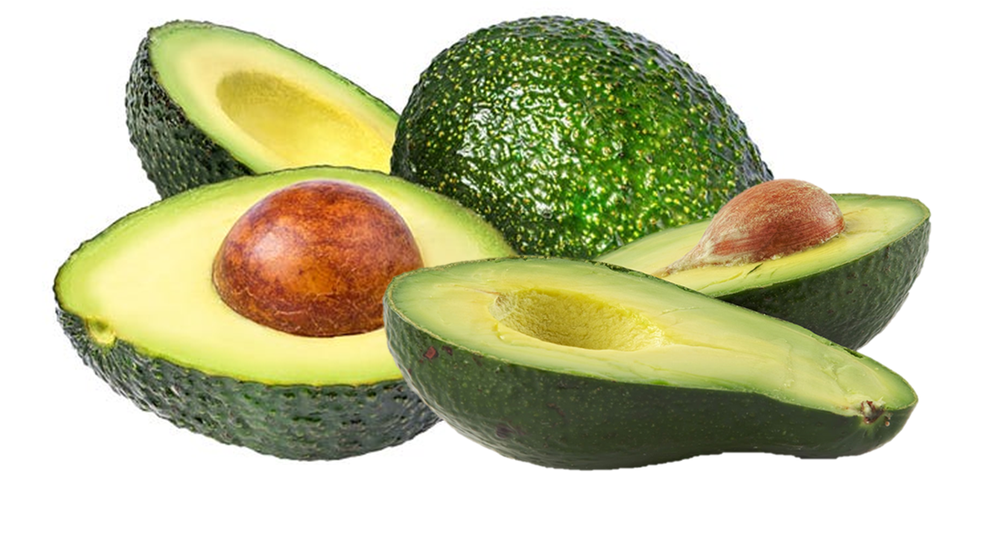
Benefits of consuming
Avocados
Avocados are rich in heart-healthy fats,
vitamins, minerals and fiber but are also high in calories.
Use to replace butter, mayonnaise or oil in recipes.
For more information, visit our website:
www.advancedhealth.com/healthy-bytes-initiative

Slide 2
Benefits of consuming
Avocados
½ large avocado provides:
166 Calories
2 gm protein
6 gm fiber
15 gm fat
No cholesterol
For more information, visit our website:
www.advancedhealth.com/healthy-bytes-initiative

Slide 3
Benefits of consuming
Avocados
Avocados contain a significant amount of folate
important for tissue growth and healing,
and vitamin K for blood clotting and bone health.
For more information, visit our website:
www.advancedhealth.com/healthy-bytes-initiative

Slide 4
Benefits of consuming
Avocados
Avocados provide antioxidant vitamins C and K
for healthy immune function and neutralizing damaging free radicals,
and B vitamins for energy production.
For more information, visit our website:
www.advancedhealth.com/healthy-bytes-initiative

Slide 5
Benefits of consuming
Avocados
Avocados are a good source of both soluble and insoluble fiber
that contribute to lower blood sugars, lower cholesterol
and contribute to feelings of fullness.
For more information, visit our website:
www.advancedhealth.com/healthy-bytes-initiative

Slide 6
Benefits of consuming
Avocados
Add slices to sandwiches, salads or smoothies.
Spread on toast or mix into mashed potatoes.
Use as a fat substitute for oil, butter or margarine in recipes.
For more information, visit our website:
www.advancedhealth.com/healthy-bytes-initiative

