Slide 1
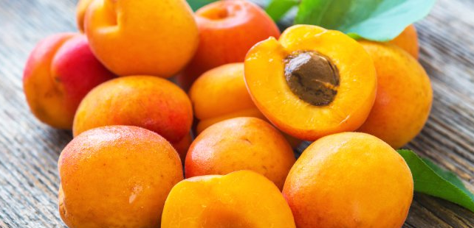
Benefits of consuming
Apricots
These stone fruit are like peaches but smaller.
They are sweet, delicious and rich in nutrition.
They can be found fresh, dried or canned.
For more information, visit our website:
www.advancedhealth.com/healthy-bytes-initiative

Slide 2
Benefits of consuming
Apricots
2 fresh or 2 dried halves of apricots provides:
34 Calories
1 gm protein
2 gm fiber
No fat
No cholesterol
For more information, visit our website:
www.advancedhealth.com/healthy-bytes-initiative

Slide 3
Benefits of consuming
Apricots
Apricots are rich in beta-carotene, converted to vitamin A
to prevent blindness and support a healthy immune system.
For more information, visit our website:
www.advancedhealth.com/healthy-bytes-initiative

Slide 4
Benefits of consuming
Apricots
Apricots are one of the best sources of potassium, a mineral
important for nerve transmission, muscle function,
including the heart, and lowering blood pressure.
For more information, visit our website:
www.advancedhealth.com/healthy-bytes-initiative

Slide 5
Benefits of consuming
Apricots
Apricots provide a variety or antioxidants including vitamins C,
E and polyphenols that neutralize free radicals
and inflammation associated with aging and disease.
For more information, visit our website:
www.advancedhealth.com/healthy-bytes-initiative

Slide 6
Benefits of consuming
Apricots
Quercetin in apricots may help provide protection against dementia.
For more information, visit our website:
www.advancedhealth.com/healthy-bytes-initiative

Slide 7
Benefits of consuming
Apricots
Dried apricot halves may be packaged with added sugars
and sulfur dioxide to preserve color, which can cause allergic reactions.
Seek out unsulfured dried fruit.
For more information, visit our website:
www.advancedhealth.com/healthy-bytes-initiative

