Slide 1
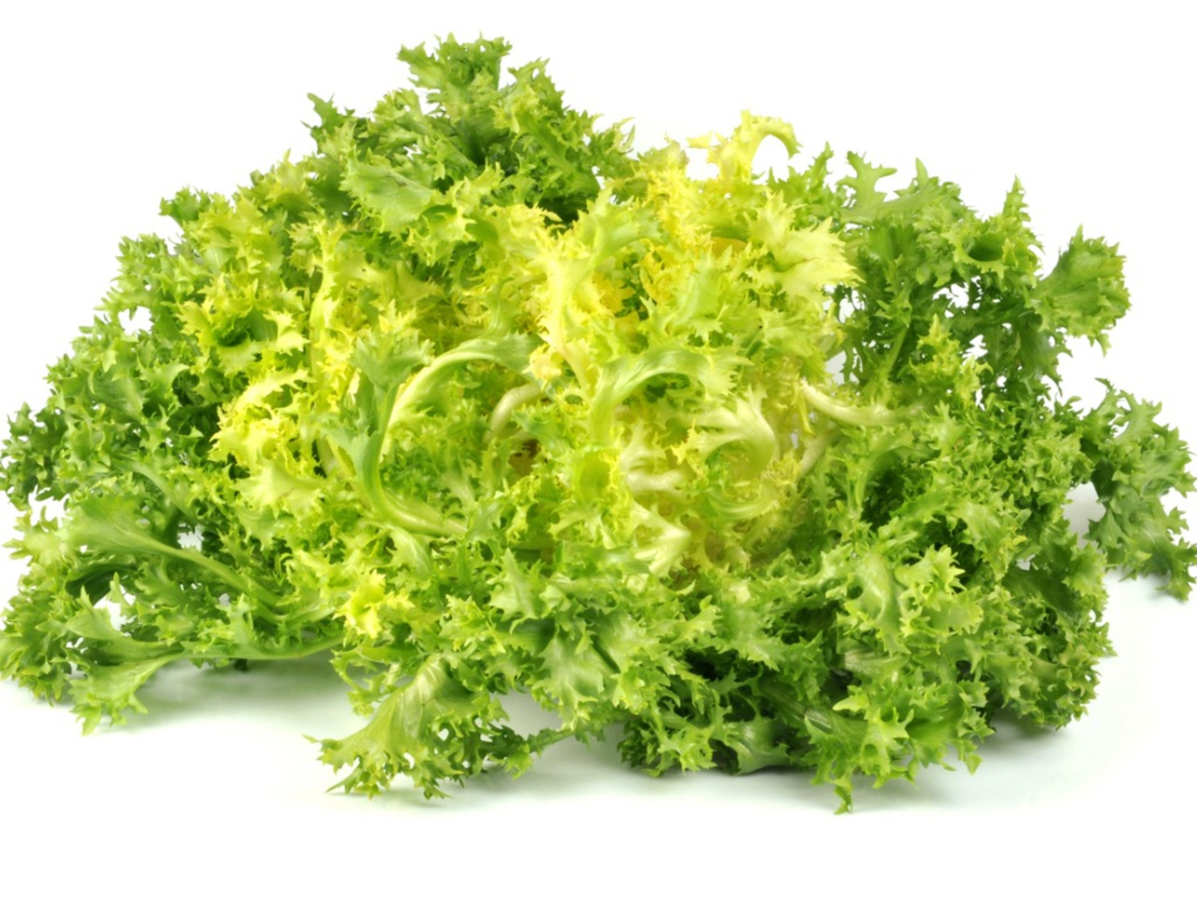
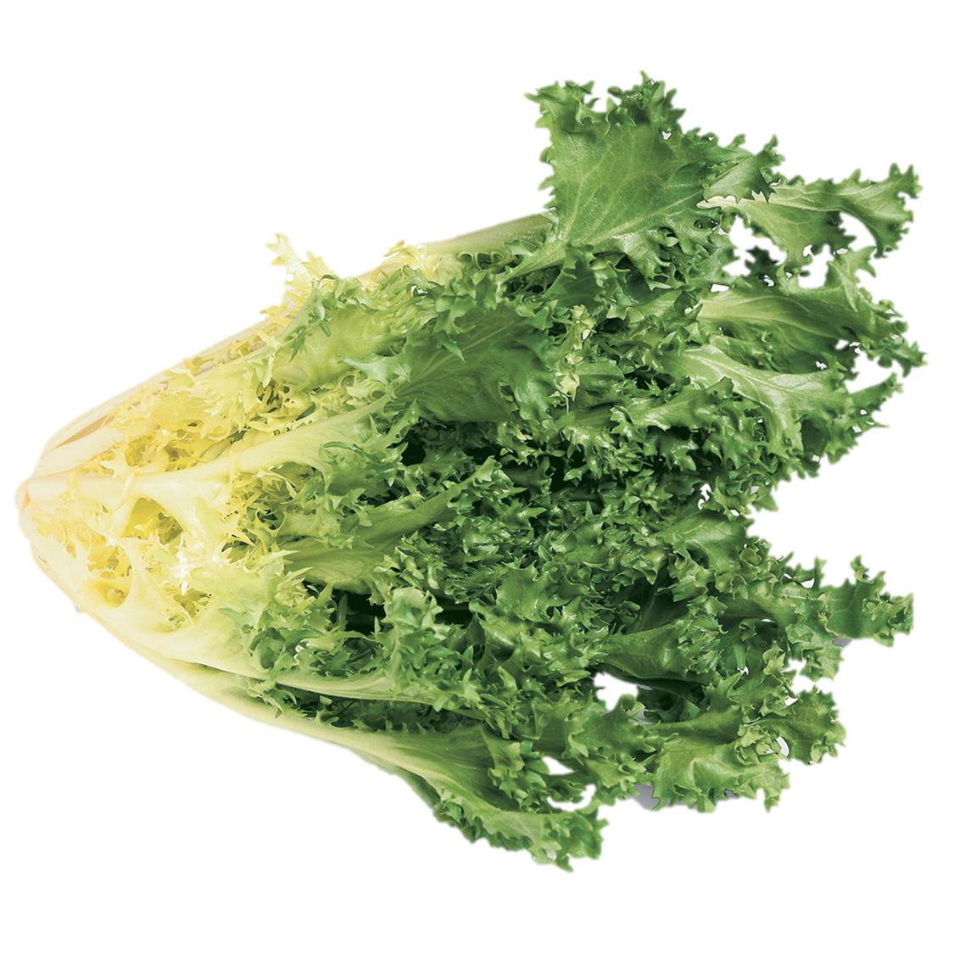
Benefits of consuming
Endive
Also called frisée (free-ZAY) or curly endive,
this leafy green is mildly bitter with a nutty taste,
making it a perfect accent to any salad.
For more information, visit our website:
www.advancedhealth.com/healthy-bytes-initiative

Slide 2
Benefits of consuming
Endive
1 cup chopped raw curly endive provides:
7 Calories
0.1 gm protein
0.1 gm fiber
No fat
No cholesterol
For more information, visit our website:
www.advancedhealth.com/healthy-bytes-initiative

Slide 3
Benefits of consuming
Endive
Like other greens, curly endive contains antioxidants
vitamin C and beta-carotene
for immune support and healthy eyesight.
For more information, visit our website:
www.advancedhealth.com/healthy-bytes-initiative

Slide 4
Benefits of consuming
Endive
Endive contains vitamin K which helps
with blood clotting and building bone,
and potassium for lower blood pressure.
For more information, visit our website:
www.advancedhealth.com/healthy-bytes-initiative

Slide 5
Benefits of consuming
Endive
Endive is rich in polyphenol antioxidants
that protect against heart disease.
Fiber in endive can reduce constipation and help with weight loss.
For more information, visit our website:
www.advancedhealth.com/healthy-bytes-initiative

Slide 6
Benefits of consuming
Endive
Endive contains kaempferol that works as an antioxidant
to lower risk of cancer by protecting against free radicals.
For more information, visit our website:
www.advancedhealth.com/healthy-bytes-initiative

Slide 7
Benefits of consuming
Endive
Mix endive with other salad greens or pair with sweet fruit
like strawberries or oranges. Add to sandwiches
or sauté with onions and white beans for a hearty side dish.
.
For more information, visit our website:
www.advancedhealth.com/healthy-bytes-initiative

