Slide 1
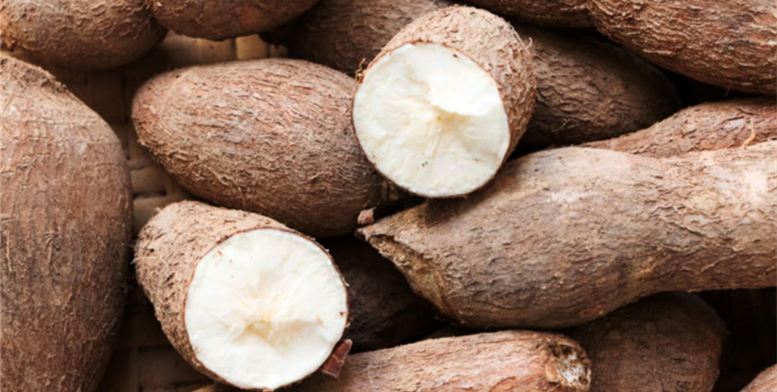
Cassava
Cassava, also known as yuca, is a root vegetable native to South America. Similar to a potato, it can be eaten whole or ground into flour.
Unlike potatoes, cassava must be soaked and cooked before consuming.
For more information, visit these websites:
www.advancedhealth.com/healthy-bytes-initiative
https://extension.oregonstate.edu/coos/healthy-families-communities

Slide 2
Cassava
1/2 cup cooked cassava provides:
192 Calories
1.5 gm protein
2 gm fiber
3 gm fat
No cholesterol
For more information, visit these websites:
www.advancedhealth.com/healthy-bytes-initiative
https://extension.oregonstate.edu/coos/healthy-families-communities

Slide 3
Cassava
Cassava is an excellent source of vitamin C
that enhances immunity.
For more information, visit these websites:
www.advancedhealth.com/healthy-bytes-initiative
https://extension.oregonstate.edu/coos/healthy-families-communities

Slide 4
Cassava
Cassava is a good source of copper
for energy production and iron metabolism.
For more information, visit these websites:
www.advancedhealth.com/healthy-bytes-initiative
https://extension.oregonstate.edu/coos/healthy-families-communities

Slide 5
Cassava
Cassava provides resistant starch which helps regulate blood sugars,
feeds healthy gut bacteria and promotes digestive health.
For more information, visit these websites:
www.advancedhealth.com/healthy-bytes-initiative
https://extension.oregonstate.edu/coos/healthy-families-communities

Slide 6
Cassava
Cassava is higher in calories than white or sweet potato.
Enjoy in moderation.
For more information, visit these websites:
www.advancedhealth.com/healthy-bytes-initiative
https://extension.oregonstate.edu/coos/healthy-families-communities

Slide 7
Cassava
The starch extracted from cassava is called tapioca,
and is mostly used for thickening.
For more information, visit these websites:
www.advancedhealth.com/healthy-bytes-initiative
https://extension.oregonstate.edu/coos/healthy-families-communities

Slide 8
Cassava
To prepare cassava, peel, chop and soak in water for 48 hours.
Then boil, roast or bake like you would potatoes.
For more information, visit these websites:
www.advancedhealth.com/healthy-bytes-initiative
https://extension.oregonstate.edu/coos/healthy-families-communities

Slide 9
Cassava
Toss cubed, cooked cassava in salad, stir fries, omelets or soup.
Grate for making cake or puree or mash.
Use flour for cakes, crackers, pancakes or tortillas.
For more information, visit these websites:
www.advancedhealth.com/healthy-bytes-initiative
https://extension.oregonstate.edu/coos/healthy-families-communities

Slide 10
Cassava
.
For recipes, visit any of these 3 websites
www.advancedhealth.com/healthy-bytes-initiative
www.coosheadfood.coop/join-us
https://extension.oregonstate.edu/coos/healthy-families-communities

